Slide 1

Schlumberger
From Transformation to Digital Transformation

Slide 2

CONTENT
Company background
Personal background
Introduction
Challenges
Strategy/Solutions
Risk & Mitigations
Conclusions
2
1
2
3
4
5
6
7

Slide 3
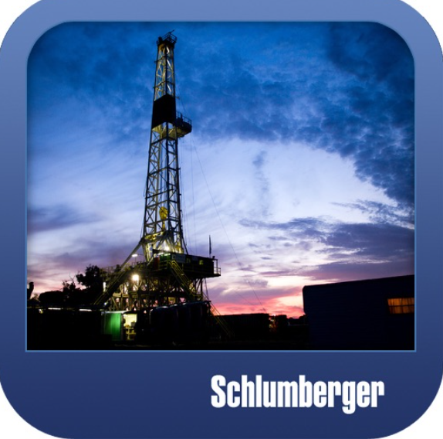
Company Background
1
2
3
Schlumberger is the leader Service Company in Oil & Gas focus on Technology
2015 the decrease on investment compels the industry to rethink
2017 DIGITAL TRANSFORMATION
95,000 people
85 countries
150,000 mobile assets
2,250 facilities
32.9 Billons (2019)
TRANSFORMATION AS PATHWAY:
“SAP”
“DIGITAL”
< OPERATING COST
OFFER OF TECHNOLOGY
IMPROVE CLIENT PERFORMANCE AND RECOVERY
www.slb.com

Slide 4

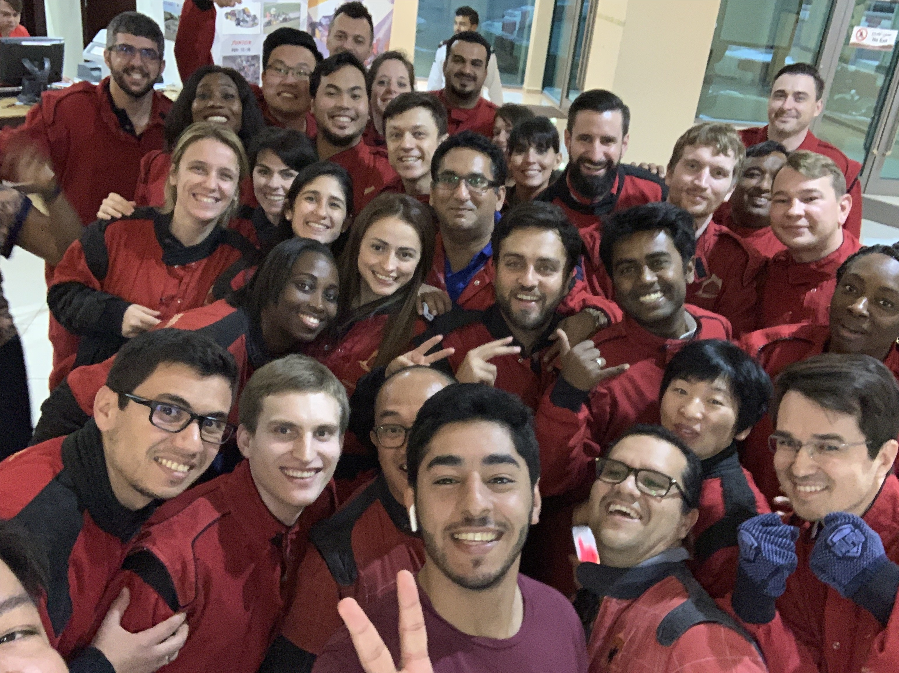

Claudia Navarro
+16 years of International experience as engineer working in operations, sales, marketing, recruiting and human resources
Work in sales leads positions in main markets: LATAM, NAM and Middle East interacting with SaaS for Sales: CRM Dynamics, C4C, Salesforce
Tech oriented, always part of groups implementing new technologies internally and offering new capabilities to clients including data visualization, real-time decision operations and billing and drone implementation
B. S Petroleum Engineering
Colombian
Schlumberger
Pet

Slide 5
Challenges
Large international enterprise
Digitalization as priority to capture market and attract stock investors
Due to the vast operation intensive alignment and preparation before any action that will affect international business systems
Executive leadership not familiar with transformation/Cloud migration

Slide 6

Transformation Strategy
Learning
Stablish common understanding
Cloud Computing/SAP
Assessment
Current status (workflow)
Resources: people, Infrastructure, softwares, licenses
Critical Data/IT Operations
Identify critical data (customer data)
Identifying critical IT operations
Major IT challenges
Cloud benefits
Why moving to Cloud will create benefit
Migration Plan
Cost evaluation
Challenges/ Risk
Understanding the challenges
Evaluating different scenarios and risk assessment
Developing a migration plan

Slide 7
Solutions/Implementation
Training
Creating a cross functional international background team in charge of transformation
New Cloud Training for IT
Cross train/hire managers with experience
New Enterprise Solutions
SAP
Windows
Multicloud Providers: Azure, GCP
HashiCORP
Scale Plan
SAP implemented only in Ecuador first in 2018
Scalability and test before full deployment
IT Response team to evaluate pilot
SLB Selected Google as preferred (Google rejected)
Status
SAP implemented and under process review, still lesson learns and plans pending
SLB working to offer DELFI (Cloud based software)
Hybrid environment suits better internal and external customer requirements
IMPORTANT FACTS
Transformation start in 2015, SAP deployment was completed in Q1 2020
Cloud migration still in process, Schlumberger partner with IBM to fully used Redhat Open shift to create a Cloud collaborative environment, DELFI

Slide 8
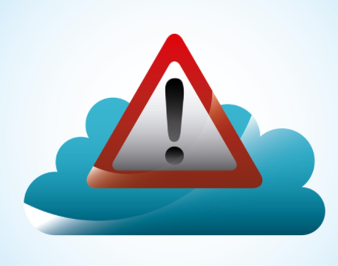
Risk & Mitigations
RISKS
MITIGATION
Security
Data from clients in the Cloud
DevOps
Talent training/retentions (rolling eyes)
Overprovisions?
Secret Management
Secret management system should be integrated to Schlumberger workflow
Identity and encryption softwares
Update hiring/recruiting process
Cost Controls for provisions (Terraform?)

Slide 9
Conclusions
Cloud adoption is dictated by current unstable Oil price and Tech companies capturing the stock market
A transformation was implemented only focus on SAP. Other enterprise solutions were identified in order to address challenges as security and DevOps
Schlumberger had to review financials and sell some of business units in order to have a lean and efficient organization.
The partnership with different Cloud providers and companies streaming the multicloud adoption will help a large organization as Schlumberger during migration, implementation and reinvention process:
Schlumberger is reinventing and moving from a static, secrecy environment to a project aiming the collaboration and global access of E&P companies trough Cloud solutions: DELFI
https://www.forbes.com/sites/adrianbridgwater/2020/09/08/ibm-red-hat-schlumberger-drill-new-channel-to-data-interoperability/#79a24d831635

